Slide 1
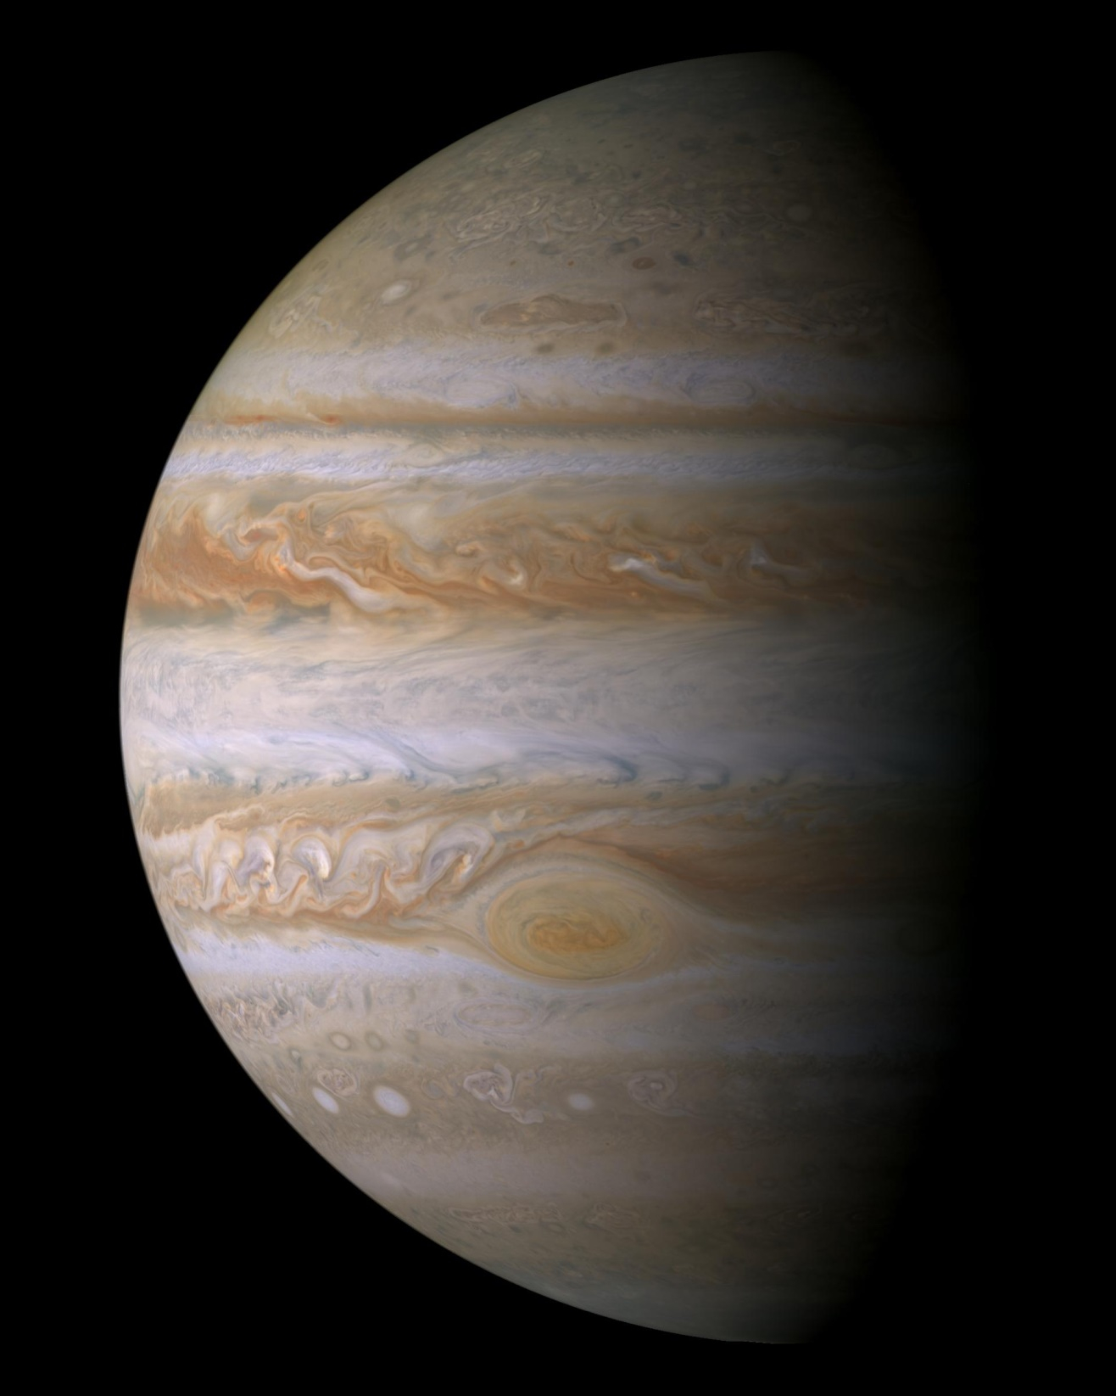
Jupiter

Slide 2
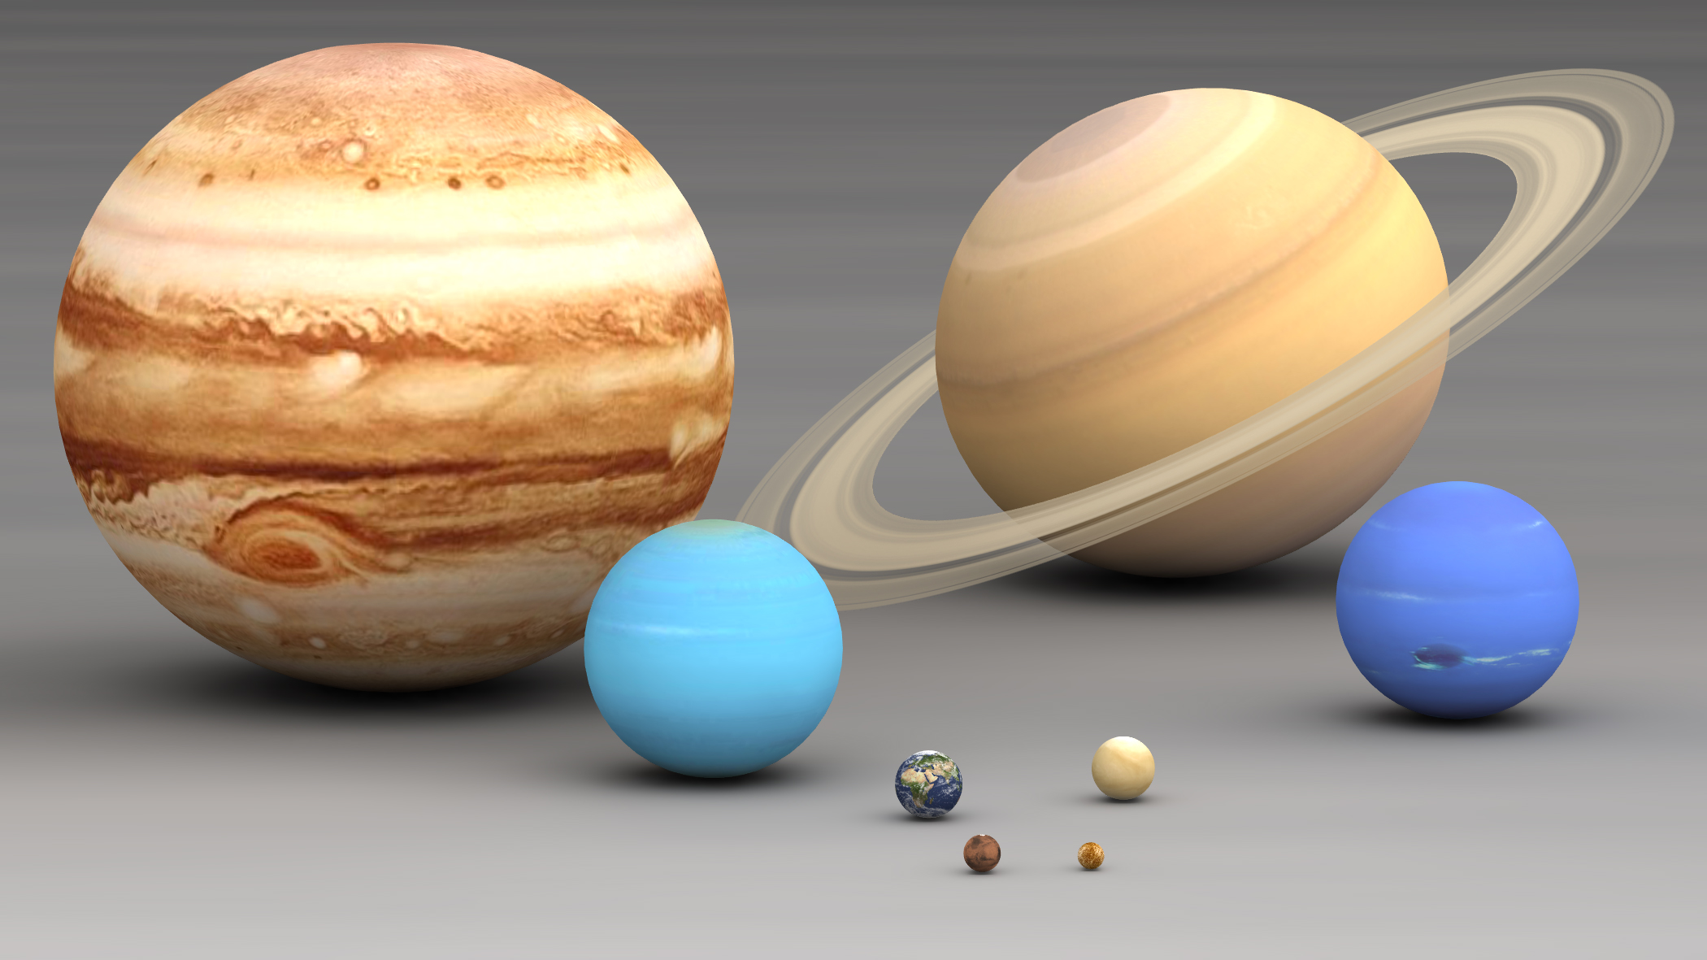
Jupiter:
The largest planet
88,900 miles in diameter
10x larger than
Earth
29x larger than Mercury
All the other planets combined could fit into Jupiter

Slide 3
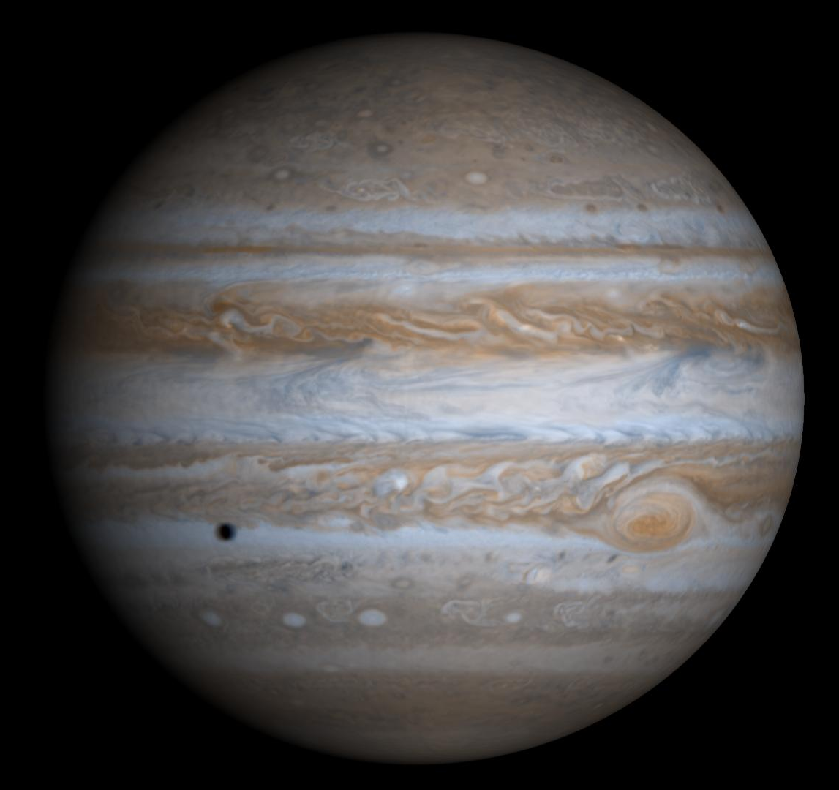
Jupiter:
Orbits the Sun every 11.8 years
Rotates fully every 9.9 hours, spinning so fast that it bulges in the middle.
It is 6,000 miles wider than it is tall.
Fastest spinner in the solar system.

Slide 4
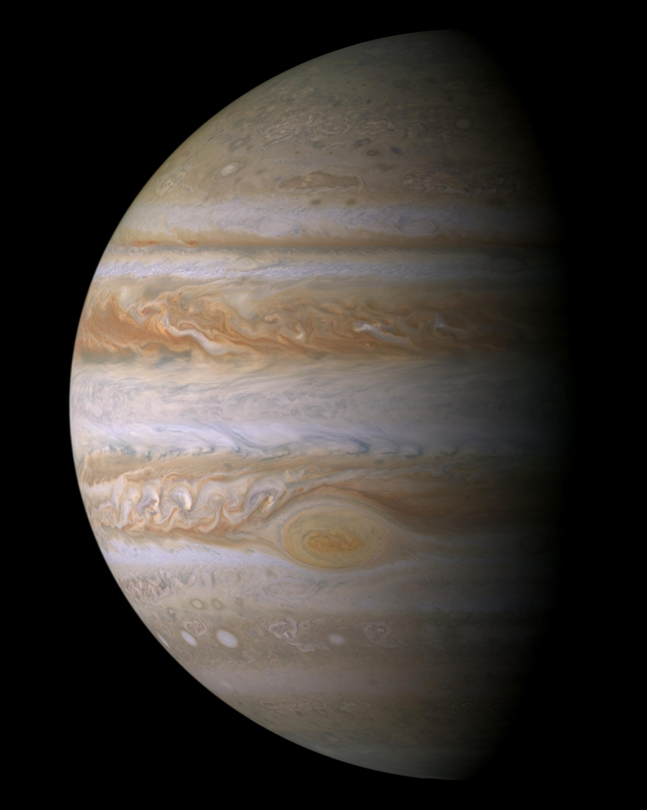
Jupiter:
483 million miles from the Sun (Earth is 93 million)
Sun shines with just 4% the brightness that Earth receives.
Its gravity is so great that it produces its own heat. It puts out more energy than it receives from the Sun.

Slide 5
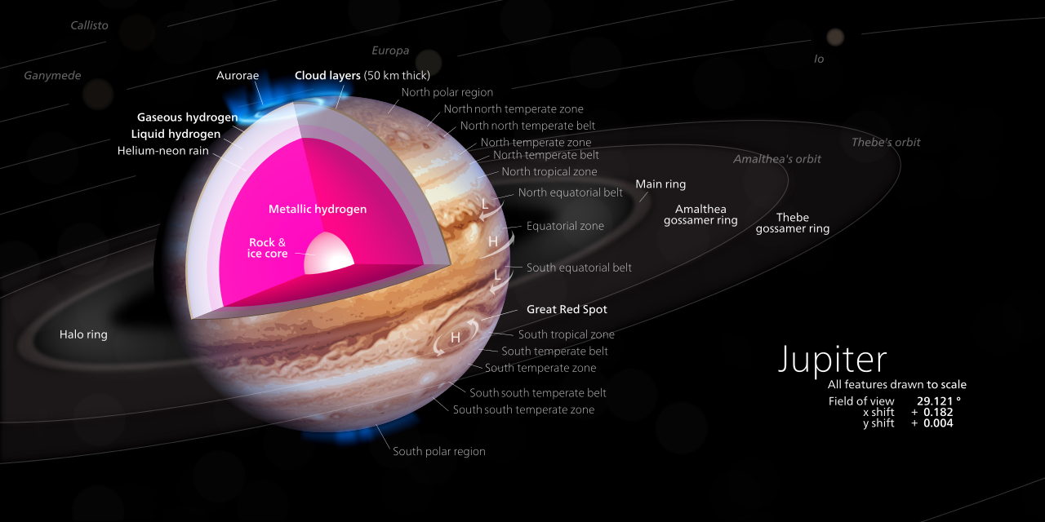
Jupiter

Slide 6
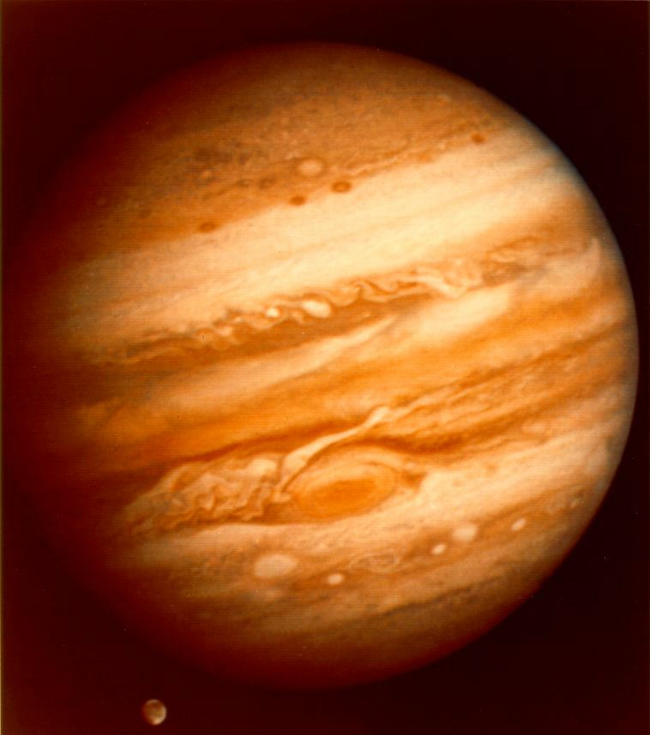
Jupiter: Failed Star?
90% hydrogen, 10 % helium
Almost the same
composition as the Sun
Only 30% smaller than a brown dwarf star
It would need to be 80x more massive to start fusing hydrogen to become a star
More mass would actually shrink its size & pull it tighter together

Slide 7
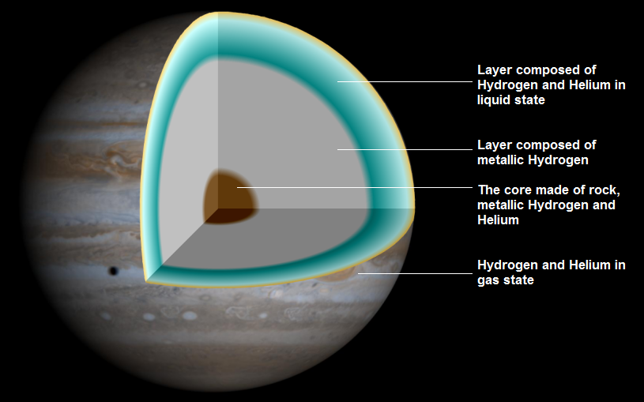
Jupiter
Outer layer temperature: 152⁰ F
Core temperature: 64,000⁰ F
(6x hotter than the surface of the Sun)

Slide 8
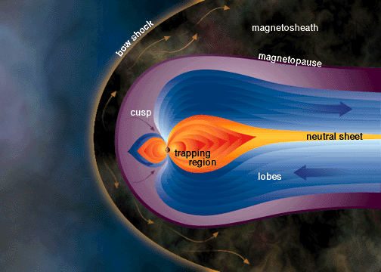
Jupiter has very strong magnetic field (14x stronger than Earth’s) that creates huge amounts of radiation as it interacts with solar wind.
Sun

Slide 9
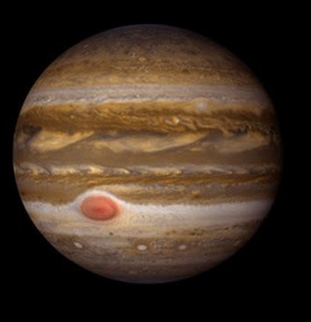
The Great Red Spot
A storm that has been raging for at least 300 years.
It is 3x as big as Earth
The storm is in the upper atmosphere, about 5 miles above surrounding clouds
It rotates counterclockwise
It fully rotates about every 6 days

Slide 10
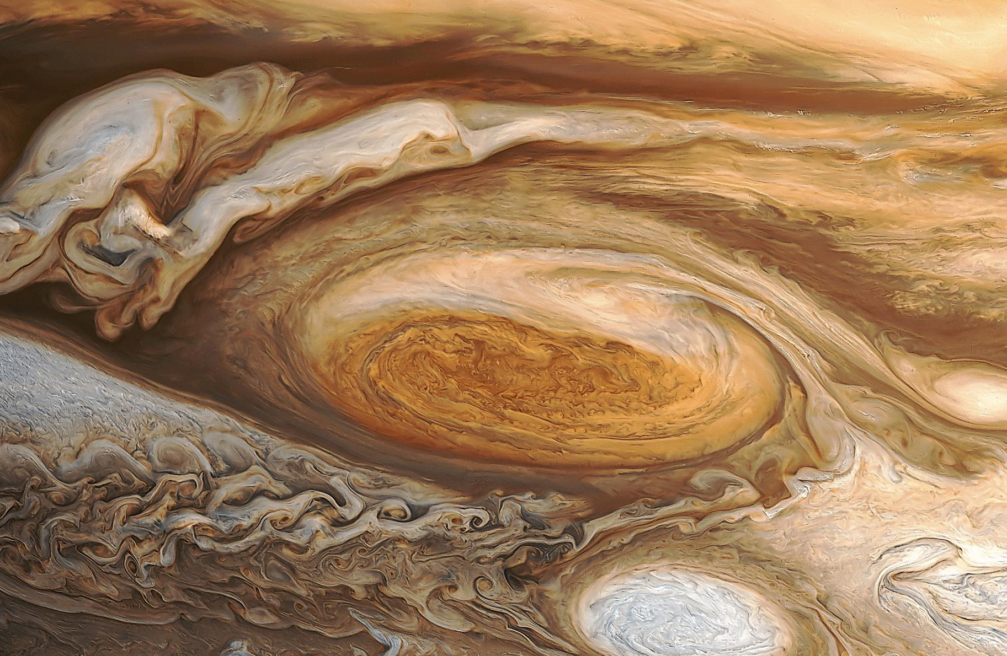
The Great Red Spot

Slide 11
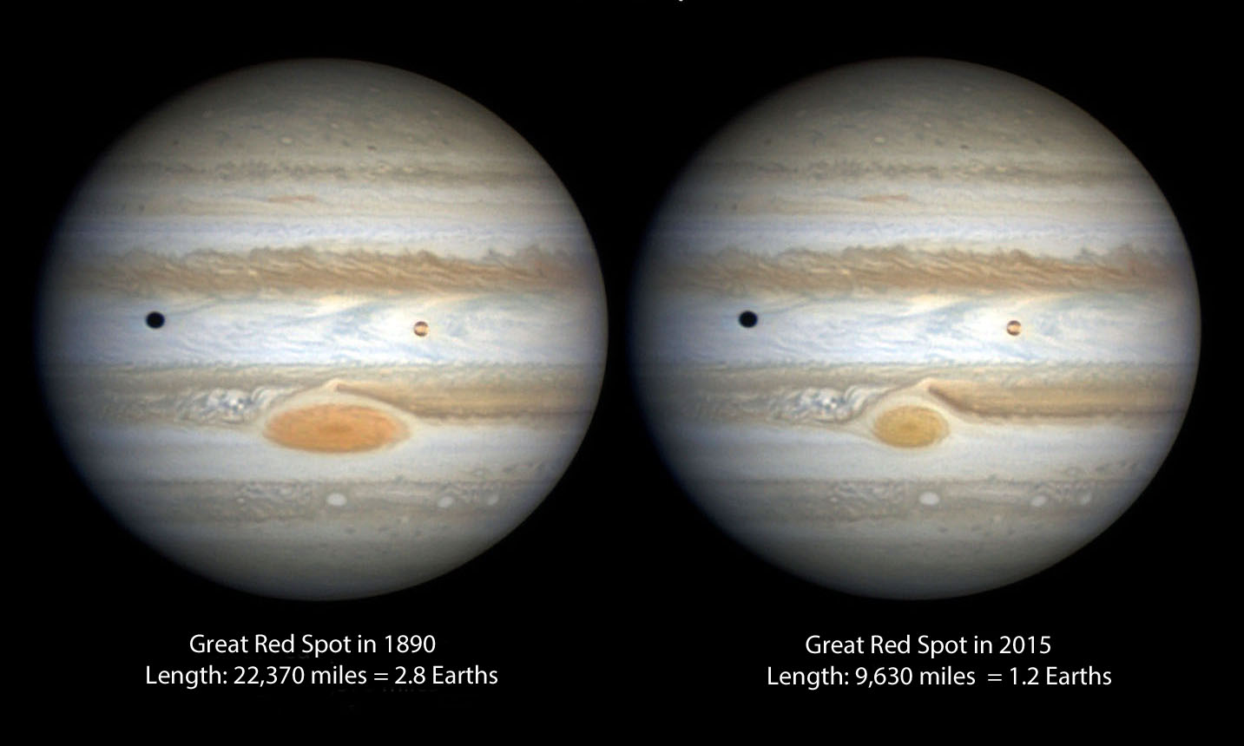
The Great Red Spot is shrinking.

Slide 12
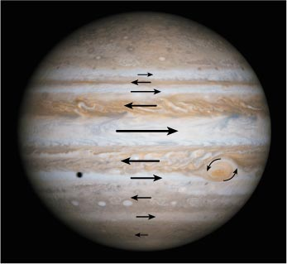
Jupiter’s Rotating Bands
Rotate in different directions
Made from frozen ammonia crystals
Various colors come from phosphorus or sulfur getting pushed to clouds & reacting to sunlight

Slide 13
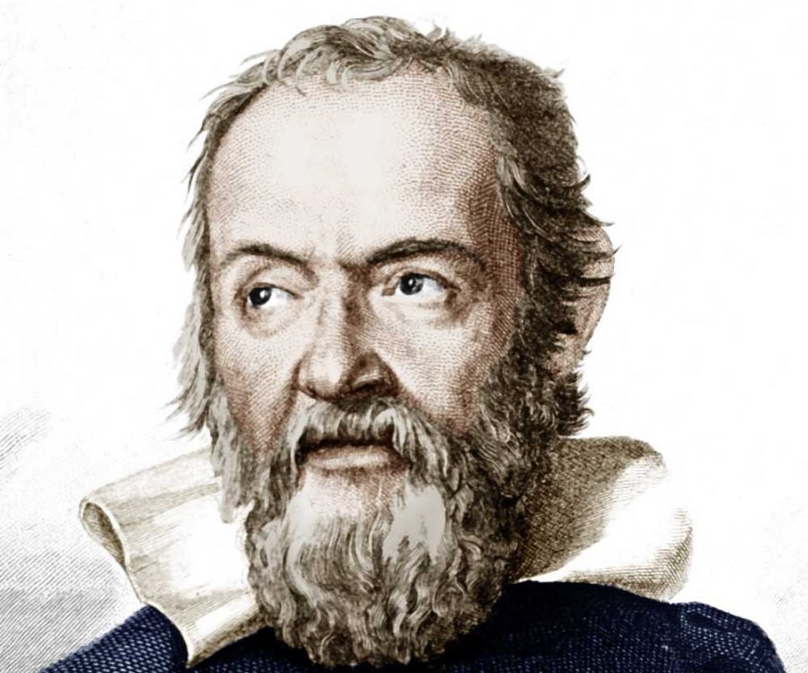
Jupiter’s moons were discovered by Galileo on January 7, 1610 using a telescope that was only 2 feet long.
His discovery helped change the way humanity viewed the universe, theology, and even God.

Slide 14
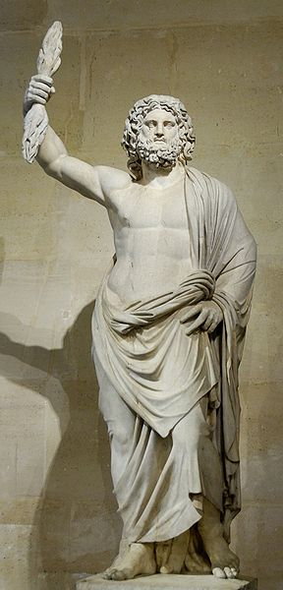
Jupiter is named after the king of the Roman gods. Jupiter was the god of sky and thunder.

Slide 15
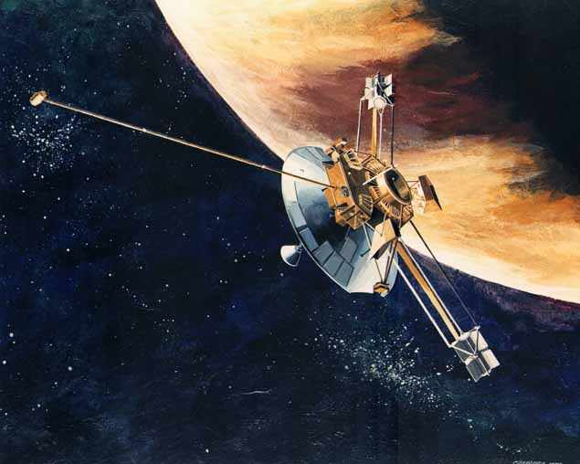
Pioneer 10
in December, 1973 was the first spacecraft to fly by Jupiter.
Other fly-bys:
Pioneer 11 (Dec, 1974)
Voyager 1 (Mar, 1979)
Voyager 2 (July, 1979)
Ulysses (1992 & 2004)
Cassini (Dec, 2000)
New Horizons (Feb, 2007)

Slide 16
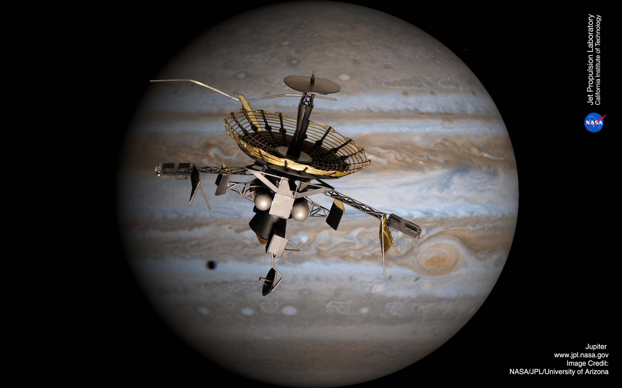
Galileo orbited Jupiter from 1995-2003.
Its primary mission was to study Jupiter’s atmosphere and moons.

Slide 17
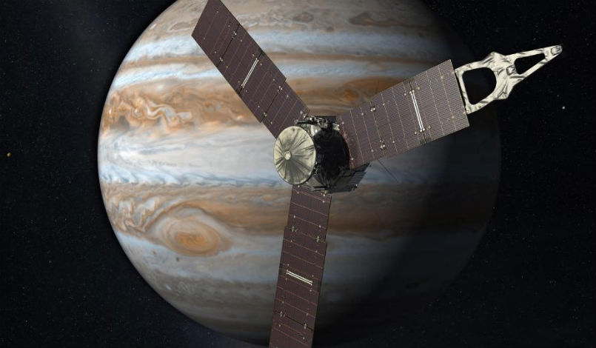
Juno is currently orbiting
Jupiter.
It arrived
in July
2016.
Its primary
mission is to
study Jupiter’s magnetic field, radiation & gravity.

Slide 18
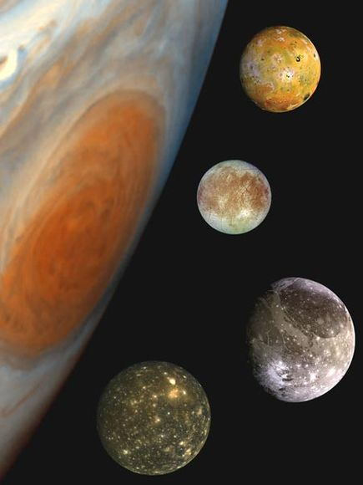
Jupiter has 67 moons. Many are no more than 20 miles wide.
There are 4 big moons called the Galilean moons.

Slide 19
The Galilean moons are named for the lovers of Zeus:
Io
Europa
Ganymede
Callisto
All of them are heated through gravitational stretching.

